Slide 1
EEE211 - Electronic Circuits and Systems
Specification & Statistics

Slide 2
Module Title: Electronic Circuits and Systems
Module Code: EEE211
Department: Electrical and Electronic Engineering
Module Level: Level 2
Module Credits: 5

Slide 3
Instructor: Sanghyuk Lee
Office: EE310, EEBuilding
Telephone: +86-(0)512-8816-1415
Email: Sanghyuk.Lee@xjtlu.edu.cn
Office Hour: Tue 1 -3 PM

Slide 4
Assessment Method
Sequence | Method | Duration | % of final mark | Resit
# 1 | Mid-term Test | 2 hours | 10% | N
# 2 | Assignment (2) | N/A | 10% for each | N
# 3 | Formal Exam | 3 hours | 70% | Y

Slide 5
Lab Session
The Design of an Operational Amplifier using Pspice
Session 1:
1) The common emitter amplifier
2) The current mirror circuit
3) The emitter follower
Session 2:
1) The differential input stage
2) The complete operational amplifier circuit
Time: Week 8 & 13
Attendance record in operation

Slide 6
Student Performance in 2012-2013
Assessment component (eg. midterm; coursework; exam; project) | Weighting | No. of Candidates | No. of Absentees | Average mark | Standard Deviation | Minimum mark | Maximum mark | Number of failures | % of failure
FORMAL EXAM (70%) | 70% | 80 | 1 | 49.04 | 18.87 | 5 | 83 | 17 | 27.85
MID-TERM TEST (10%) | 10% | 80 | 0 | 56.73 | 24.37 | 0 | 93 | 17 | 28.75
ASSIGNMENT 1 (10%) | 10% | 80 | 1 | 61.3 | 14.85 | 0 | 87 | 17 | 7.59
ASSIGNMENT 2 (10%) | 10% | 80 | 1 | 59.57 | 20.58 | 0 | 89 | 17 | 13.92
Final Marks (100%) | 100% | 80 | 0 | 51.51 | 18.16 | 0 | 84 | 17 | 21.25

Slide 7
Student Performance in 2013-2014
Assessment component (eg. midterm; coursework; exam; project) | Weighting | No. of Candidates | Average mark | Median | Standard Deviation | Minimum mark | Maximum mark | Number of failures | % of failure
FORMAL EXAM (70%) | 70% | 105 | 44.8 | 45 | 21.33 | 3 | 87 | 38 | 36.19
MID-TERM TEST (10%) | 10% | 105 | 36.16 | 32 | 22.47 | 0 | 91 | 60 | 57.14
ASSIGNMENT 1 (10%) | 10% | 105 | 58.95 | 58.3 | 14.65 | 0 | 86.9 | 3 | 2.86
ASSIGNMENT 2 (10%) | 10% | 105 | 58.87 | 63.8 | 18.55 | 0 | 83.6 | 10 | 9.52
Final Marks (100%) | 100% | 105 | 46.08 | 46 | 19 | 2 | 85 | 39 | 37.14

Slide 8
Student Performance in 2014-2015
Assessment Component (eg. midterm; coursework; exam; project) | Weighting | Credit Weight | No. of Candidates | No. of Absentees | Average Mark | Median | Standard Deviation | Minimum Mark | Maximum Mark | No. of Failures | % of Failure
FORMAL EXAM (70%) | 70% | 3.5 | 141 | 4 | 46.94 | 48 | 22.38 | 0 | 89 | 42 | 29.79
MID-TERM TEST (10%) | 10% | 0.5 | 141 | 8 | 37.26 | 35.56 | 22.57 | 0 | 90 | 73 | 51.77
ASSIGNMENT 1 (10%) | 10% | 0.5 | 141 | 0 | 66.12 | 70 | 24.63 | 0 | 100 | 14 | 9.93
ASSIGNMENT 2 (10%) | 10% | 0.5 | 141 | 0 | 65.74 | 72 | 22.83 | 0 | 90 | 13 | 9.22
Final Marks (100%) | 100% | 5 | 141 | 0 | 48.63 | 51 | 21 | 0 | 84 | 40 | 28.37

Slide 9
Attendance Record
The attendance record is in operation for lectures and lab session, which is a proof of students’ attitude on learning.

Slide 10
Aims
To understand how electronic circuits are designed.
To understand how electronic devices can be represented by simple, linear equivalent circuits.
To show how complex circuits can be sub-divided into building blocks and these blocks in turn represented by linear equivalent circuits which can be analyzed using standard circuit techniques.
To understand the interaction between the building blocks to allow estimation of important systems parameters such as gain, input output resistance etc.
To appreciate the importance of negative feedback in improving electronic systems performance and tolerance.

Slide 11
Knowledge and Understanding
On successful completion of this module the student should have:
An understanding of small signal transistor amplifier analysis and design
An understanding of the use of current mirrors for biasing and as active loads
An appreciation of the high frequency limitations of transistor amplifiers
An understanding of amplifier types and feedback topologies;
An appreciation of the control of gain, bandwidth, distortion, input and output impedances of amplifiers by the use of negative feedback;
An understanding of some operational amplifier non-idealities;
An appreciation of how the effects of these non-idealities can be controlled in amplifier design;

Slide 12
Intellectual Abilities
On successful completion of this module the student should be able to:
Compare physical device operation to engineering models
Analyse simple building blocks and show how they can be combined to form more complex electronic systems
Use the models to undertake the analysis of amplifiers with given properties
Test and analyse electronic circuits.

Slide 13
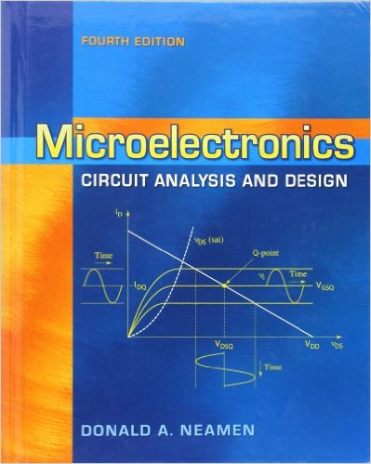
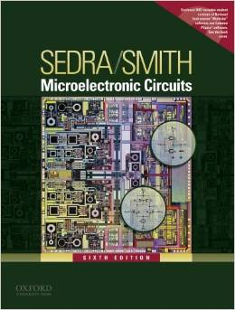
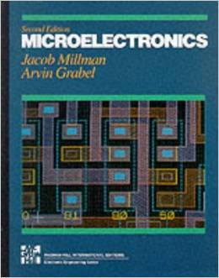
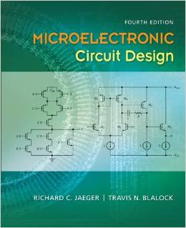
Reference Books

Slide 14
PART 1: Transistor Circuits and Multi-stage Amplification
What would we learn ?

Slide 15


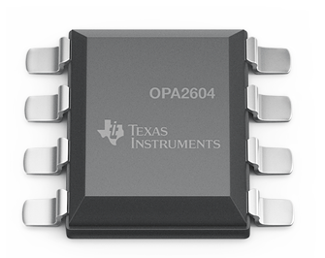
Design Oriented Module
EEE211 Electronic Circuits and Systems

Slide 16
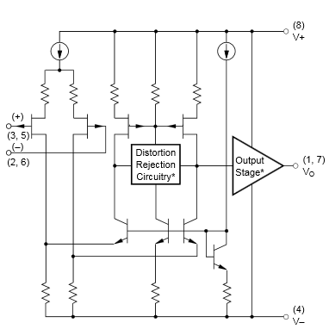
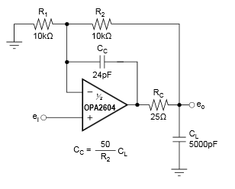
Design Oriented Module

Slide 17
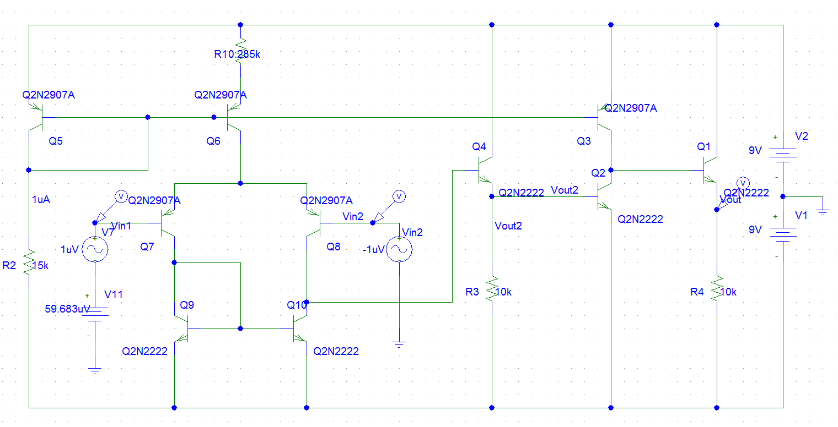
Design Oriented Module

Slide 18
Cascade Structure

Slide 19
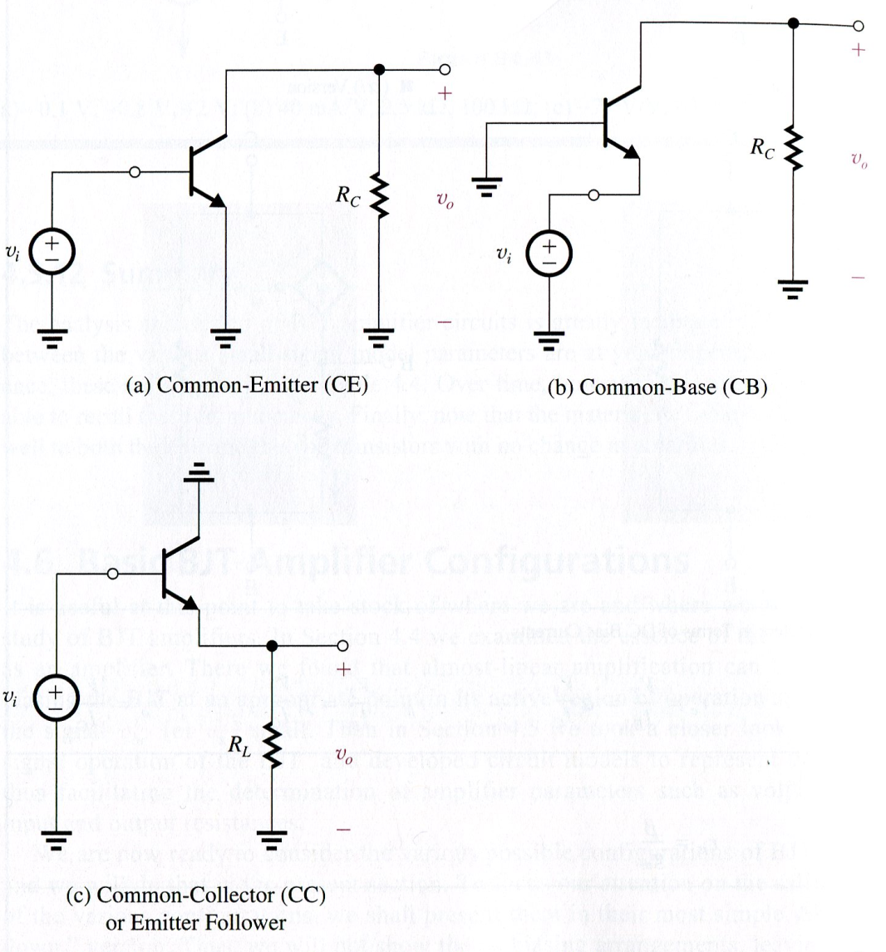
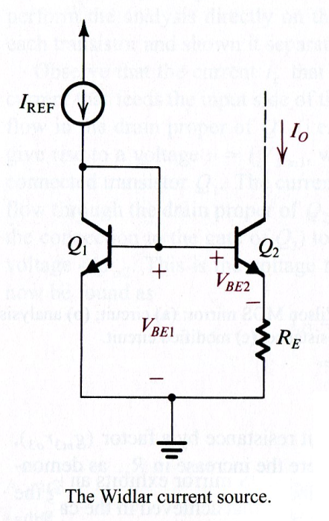
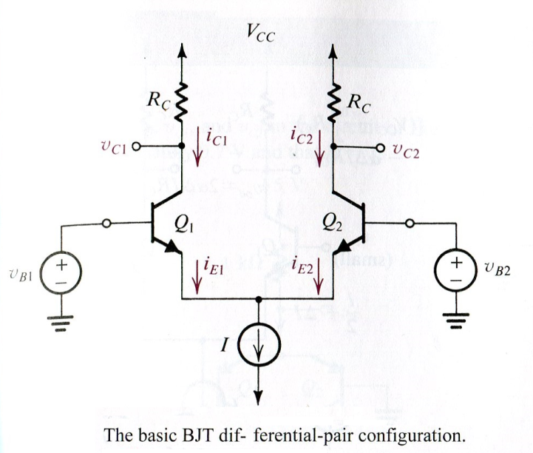
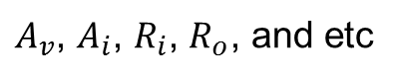
Discrete Components
$A_{v}$, $A_{i}$, $R_{i}$, $R_{o}$, and etc

Slide 20
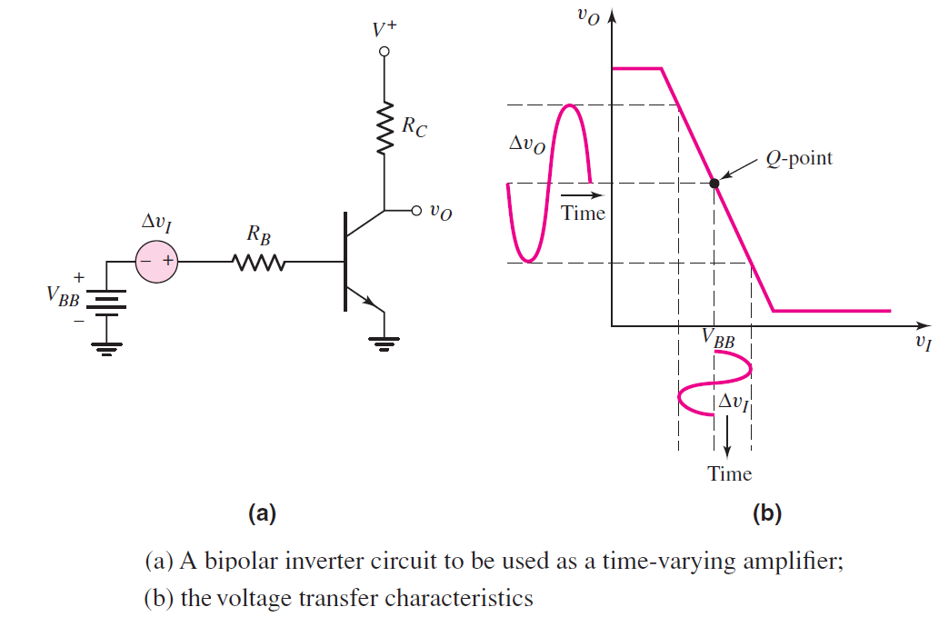
Signal Amplification

Slide 21
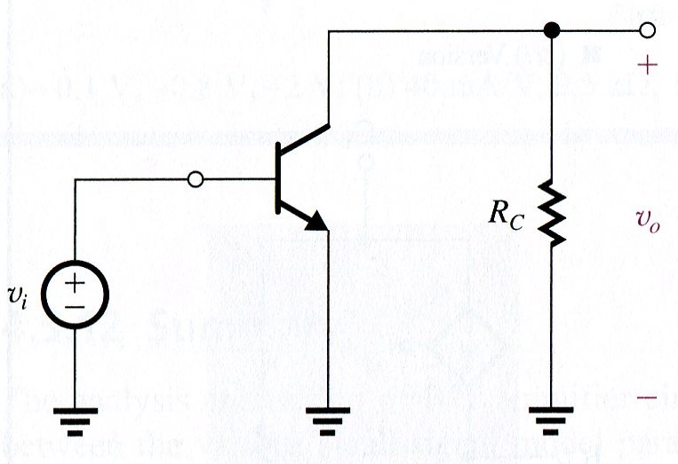
Small Signal Analysis
Small signal analysis method
R_{S}
C_{C}
i
r_{b}
i
C_{C}
i
B
C
c
v_{π}
r_{π}
g
v
r₀
m
π
v_{S}
R₁
R₂
R_{C}
R_{L}
v_{o}
E
R_{E}
C_{E}

Slide 22
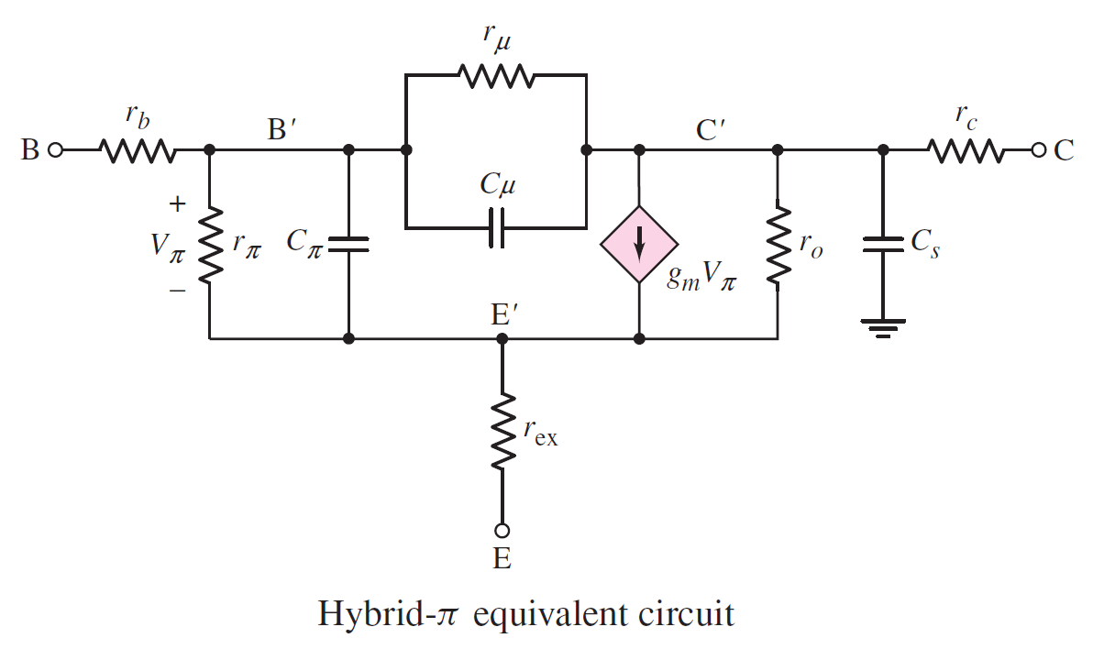
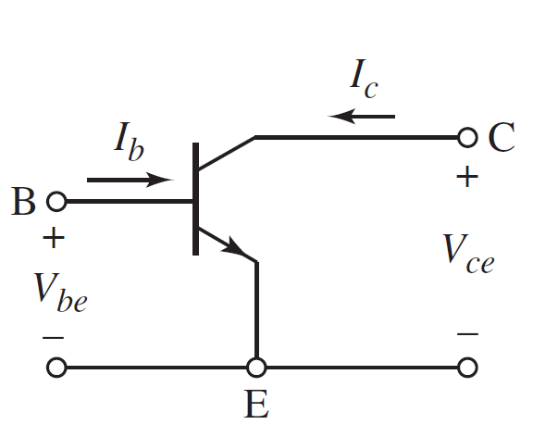
Small Signal Analysis for H.F.

Slide 23
Simplified Design (Linearization) is not Enough to Meet Performance Requirements.

Slide 24
PART 2: Feedback and Its Application on Electronic Circuits Design
What would we learn ?

Slide 25

Feedback

Slide 26
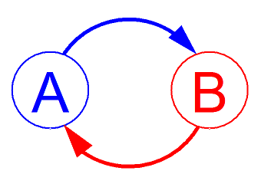
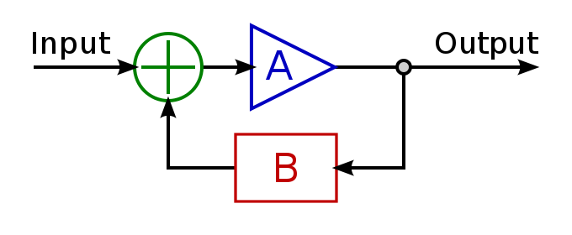
“Feedback” is one of the most important keywords in Science
Feedback occurs when outputs of a system are routed back as inputs as part of a chain of cause-and-effect that forms a circuit or loop.
-from Wiki

Slide 27
Feedback
Useful Links:
https://en.wikipedia.org/wiki/Feedback
https://en.wikipedia.org/wiki/Control_system
https://en.wikipedia.org/wiki/Mandelbrot_set
https://en.wikipedia.org/wiki/Cybernetics#The_early_20th_century

Slide 28
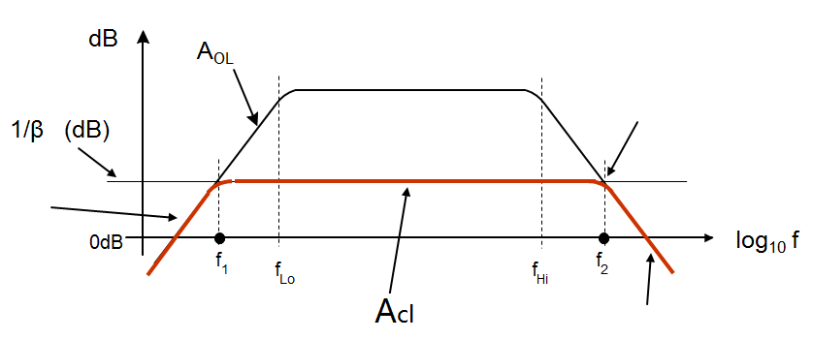
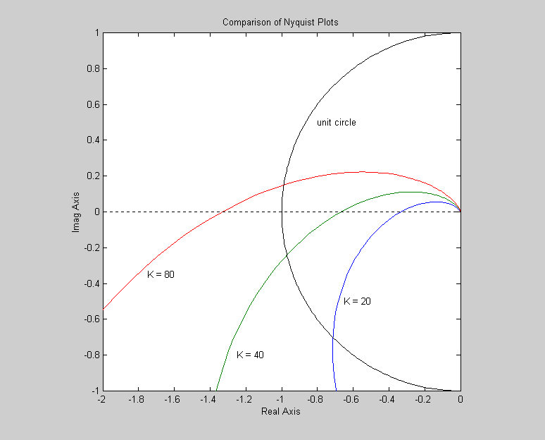
Feedback Application on Electronic Circuits
Advantage:
Bandwidth, Input-Output Impedance, Sensitivity,
and etc
Disadvantage:
Gain,
Stability ,
and etc

Slide 29
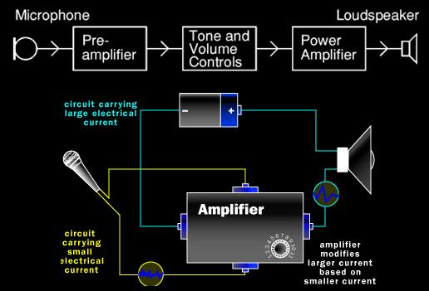
engineering-the-world-through-analog Audio System

Slide 30
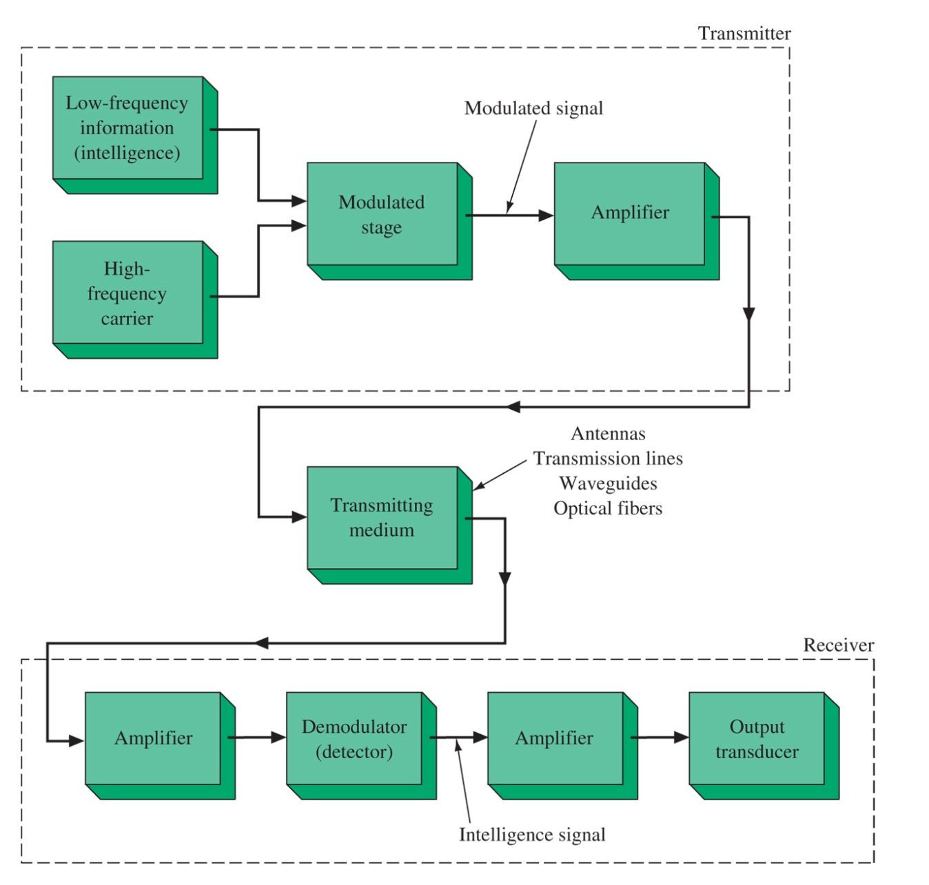
engineering-the-world-through-analog Communication Systems
Wide-band amplifiers are the essential part for communication systems, and so is power amplifier for antennas.

Slide 31
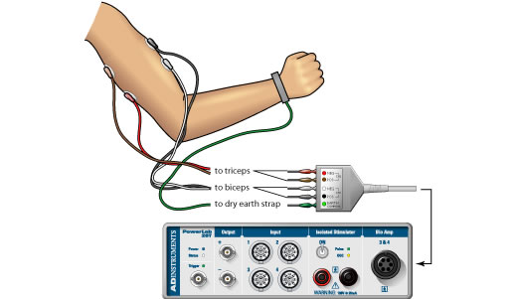
engineering-the-world-through-analog Electromyogram Detection and Analysis
Muscles generate voltages around 100 mV when they contract. These voltages are greatly attenuated by internal tissue and the skin, and they are weak but measurable at the surface of the skin.

Slide 32
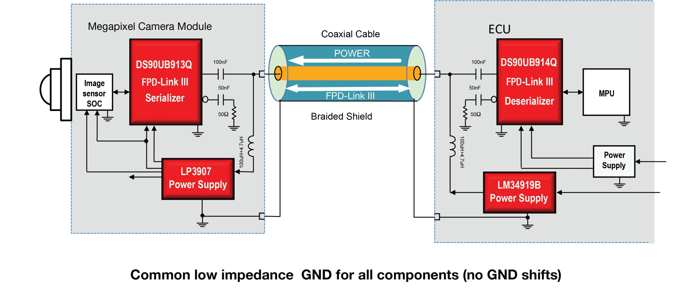
Our lives are surrounded by ANALOG everywhere we go. That’s not news to the Analog Wire audience, but it may surprise some that in this age of digital electronics, analog technology is more pervasive and impactful than ever. In everything from power tools to a runner’s heart-rate monitor to the factory robot, analog chips are managing batteries or power from the wall, converting and conditioning signals, and providing the system interface. Technology has made and will continue to make an impact on the way we live, learn, work and play.
-Hagop Kozanian @TI
http://e2e.ti.com/blogs_/b/analogwire/archive/2013/06/07/engineering-the-world-through-analog

Slide 33
END

